Slide 1
An industry leading, full service data collection and analysis tool, that is secure, scalable and rapid.
June 2024

Slide 2
Solution

Slide 3
LP+ OASIS is a secure, scalable, cloud-based full-service survey, data collection and analysis tool.
It offers the ability to use any number of frameworks to collect data for either gap analysis or maturity measurement models.
Each respondent is given a personalised reflection of their responses creating an individualised development plan. These can be linked to relevant external resources.
The analysis from the survey identify gaps for intervention or development required for better outcomes. These are presented in an AI-driven interactive dashboard as well as an insights report, offering priorities and comparators.

Slide 4
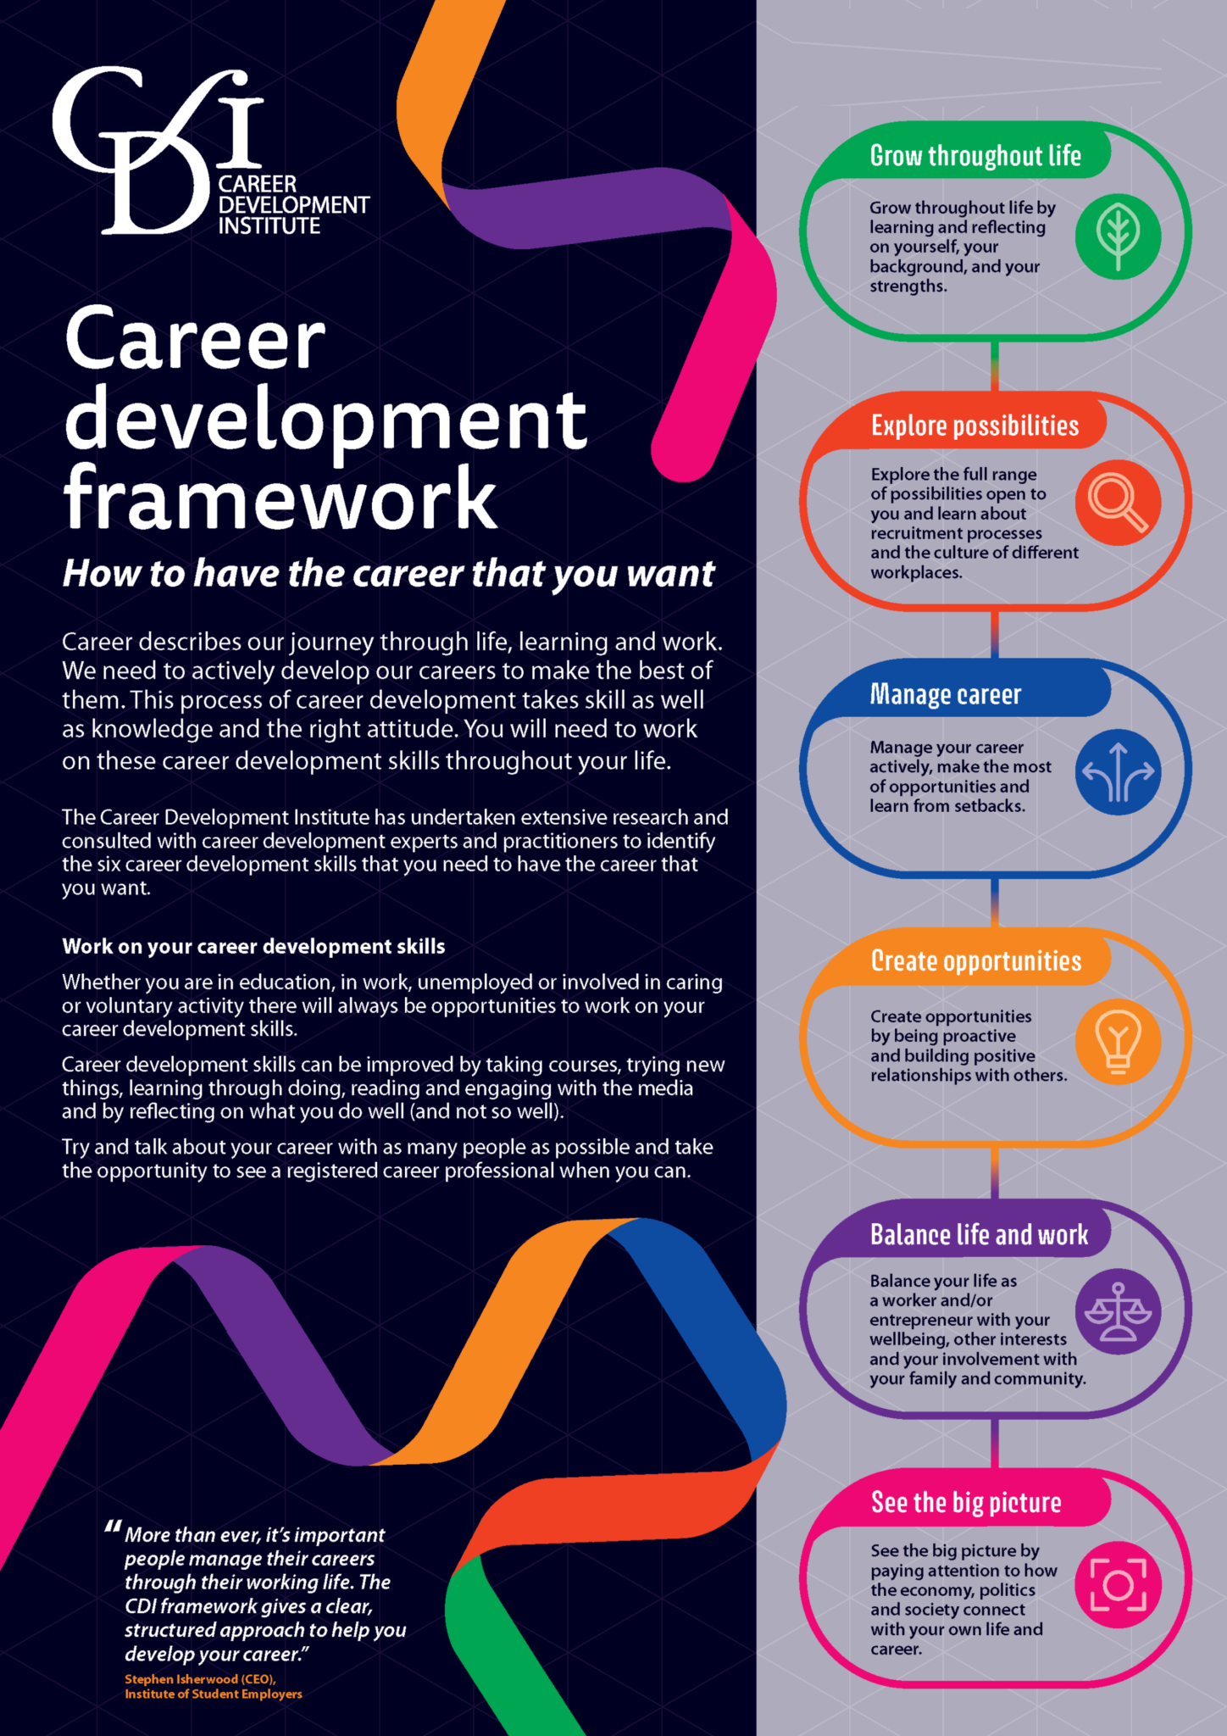
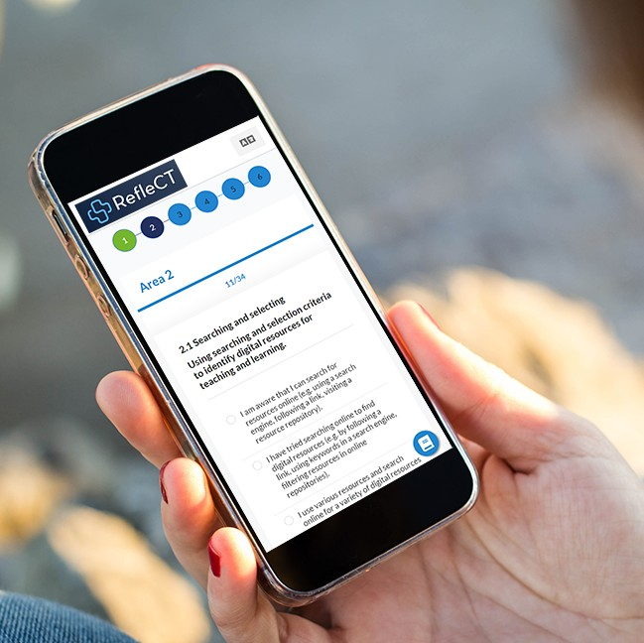
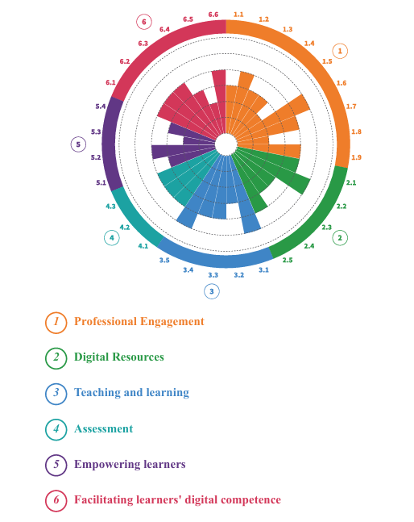
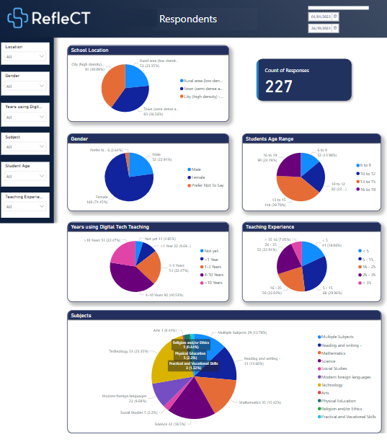
LP+OASIS Ecosystem
Maturity and System Analysis Frameworks
Survey on any device on or offline. Distribute on Social Media.
Personalised Reflection Analysis
Survey Questions Languages Glossaries
Targeted Intervention
Courses, Resources, Certification
AI Driven Dashboards
interactive and customised
Insight Report including comparisons and priorities

Slide 5
Solution Outline
Data
Survey tool presentation
Framework
Surveys Questions
Full data sovereignty with GDPR compliant data collection and secure storage in the MS Azure cloud.
Branding options with choice of any language(s).
service on-demand
Preselected or self-defined frameworks and questions.
Surveys offer a choice of multiple choice, Likert and open questions
Surveys Scoring
Personalised Reflection report
Interactive Dashboard
Registration Portal
Personalised rubrics, allowing weighting and achievement levels
Reflection of survey responses with analysis and levelling up suggestions.
Data analysis and insights with interactive filters.
Ability to register respondents through a customised portal.

Slide 6
Survey Distribution
Compatibility
Connectivity
Distribution
Works on Mobiles, Tablets and PC’s and compatible with all internet browsers
Works in low bandwidth areas and continues if the connection is lost, allowing you to submit when you are back online.
Share by email, text or social media.

Slide 7
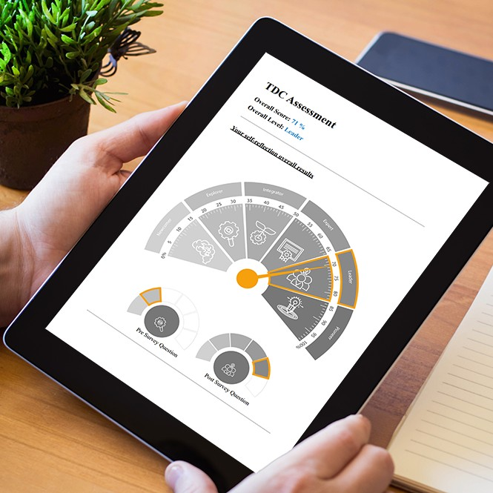
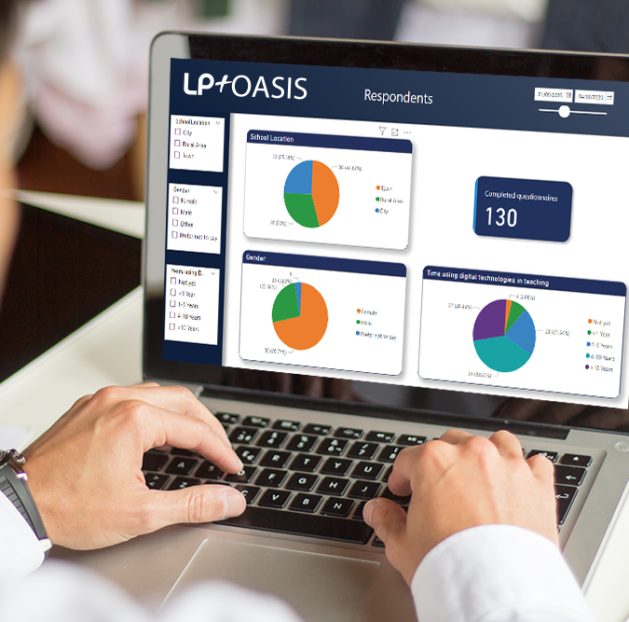
Survey Outputs
Once LP+OASIS commences, the following outputs are usually achieved within 6-8 weeks.
User Reflections
Interactive Dashboards
Insight Report
Certification
Personalised reflection reports allow respondents to
analyse responses and understand how to level up.
Drill into the full data set and analyse using the interactive filters available.
Data-evidenced insights. Actionable recommendations. Prioritisation for impact
User participation certificates are available

Slide 8
Roadmap AI Integration
Insight Dashboard
What If
AI Insight Report
AI enhanced dashboards displaying the effect and influence of key factors on your results. Conduct root cause and ad hoc analysis to understand the effect of Key factors across the different fields within your data.
Allowing you to Interactively tweak parameters and immediately see the potential outcomes
AI enhanced Insight Reports not only identifying patterns but also predicting future trends and offer actionable recommendations.

Slide 9
Frameworks

Slide 10
What is a framework?
In LP+OASIS a framework is a set of, typically, 6 pillars with each pillar defining an area to be measured for gaps or to assess a level of maturity. These can be then addresses through targeted interventions or development programs that are individualised to the respondent.

Slide 11
Cambridge Data Collection Framework
20-minute surveys for teachers, school leaders, combined with interviews and desk research provide rapid insights in 3 months.
School profile
School quality management
Teacher profile
Stakeholder understanding and enactment of policy
Classroom practice
Custom questions

Slide 12
ADB Teacher Digital Maturity Framework
1- Professional Engagement
2- Digital Resources
4- Assessment
6- facilities learning digital competence
Organizational communication
Online learning environment
Professional collaboration
Digital technologies and school level infrastructure
Reflective practice
Digital life
Professional learning (through digital technologies)
Professional learning (about digital technologies)
Computational thinking
Searching and selecting
Creating
Modifying
Managing and protecting
Sharing
Information and data literacy
Communication and collaboration
Content creation
Safety and wellbeing
Responsible use
Problem solving
Assessment strategies
Analying evidence
Feedback and planning
5- Empowering learning
3- Teaching and Learning
Accessibility and inclusion
Differentiation and personalization
Actively engaging learners
Blended learning
Teaching
Guidance
Collaborative learning
Self-regulated learning
Emerging technologies
Pioneer - I initiate/contribute (to the school or community)
Leader - I support (others) / involve students
Expert - I analyze / reflect / redesign
Integrator - I use
Explorer - I have tried
Newcomer - I am aware
C2
C1
B2
B1
A2
DigCompEdu
A1

Slide 13
Case Study

Slide 14
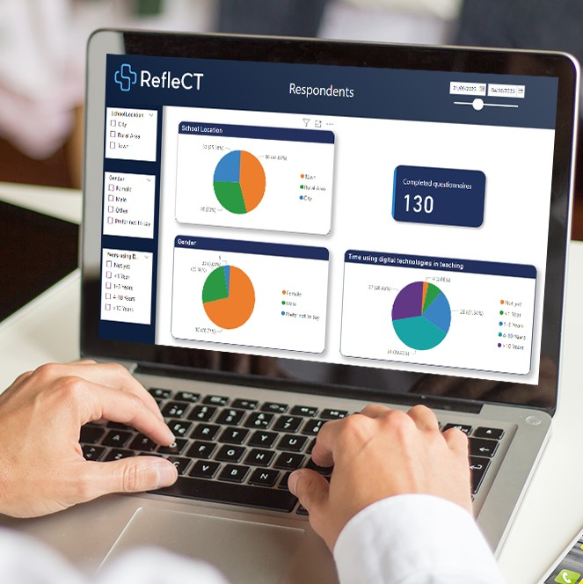
Deployed by ADB in Uzbekistan, Cambodia , Philippines, Vietnam, and Indonesia
Case Study – LP+ OASIS branded as ADB RefleCT
User Surveys for
Measurement
User Reflections for
Personalised Development
Interactive Data
Visualisations

Slide 15
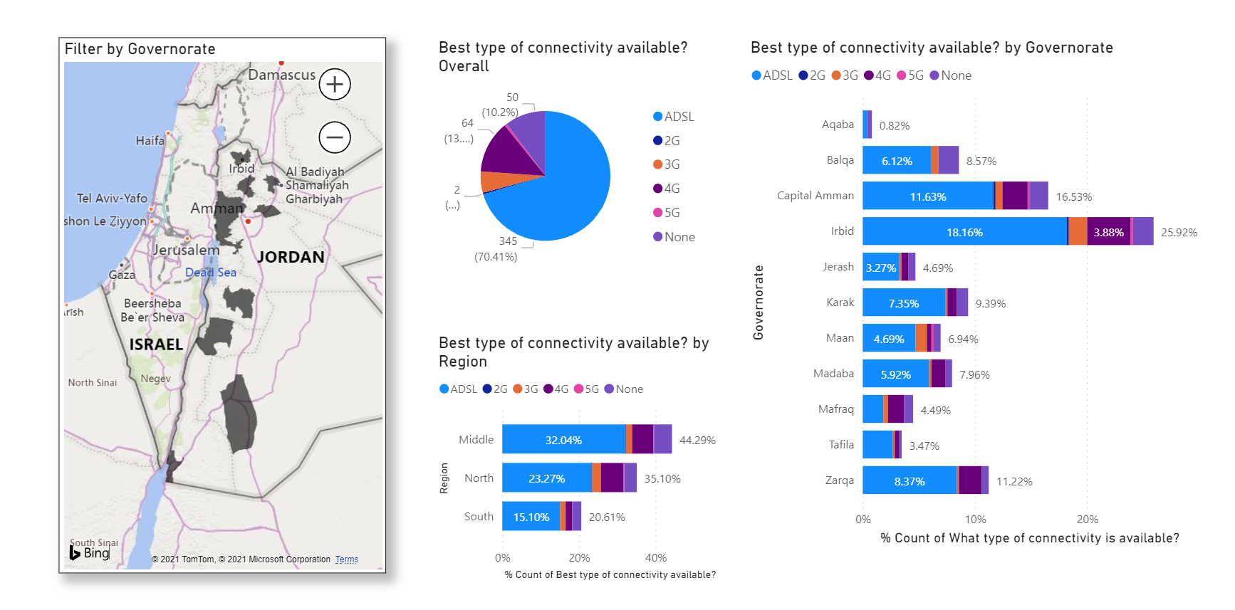
LP+OASIS provided Jordan MOE to accurately assess their digital status and readiness through surveying all stakeholders.
Case Study – Digital Readiness in Jordan
LP+OASIS provided interactive dashboards and detailed analysis of the digital status and readiness throughout the country.
A written report provided a detailed assessment of the current digital status and readiness, including comparisons with other countries and recommendation to improve.

Slide 16
Commercials

Slide 17
Overall commercial pricing model
Pricing for LP+ OASIS is bespoke, depending on the options chosen from the menu below.
Each project is usually composed of either a fixed price setup and project cost, or a setup cost and a cost per school,
Prices typically range from £50,000 to £250,000
Description
12

Slide 18
Setup options
The following can be customeised to your requirements
Solution Branding
Framework and survey questions
Reports (Insights and Reflections)
Interactive Dashboard
Registration Portal
Language(s)
Survey distribution options
Cloud storage options
Description
13

Slide 19
Project/school pricing options
The following can be customeised to your requirements
Project size and scale
Project based or school based pricing
Target response numbers
Description
14

Slide 20
15

