Slide 1
An industry leading platform offering full online courses, professional development, vocational training, assessment and certification, that is secure and scalable.
June 2024

Slide 2
Solution

Slide 3
LP+ ADOPT is a secure, scalable, cloud-based full-service online courses Professional Development, Exams and certification tool.
It offers rich authoring experience and interactive content with multimedia, animation and simulation.
Create communities for discussion and peer -to-peer learning around course content. Role based access for moderators and administrators.
Assign exams with certification, with options to use question banks. Exams can be timed, proctored, and auto-marked.

Slide 4
Solution Outline
Data
Course Authoring tool
Assessment
Types
Question
Banks
Full data sovereignty with GDPR compliant data collection and secure storage in the MS Azure cloud
Branding options with Multi-lingual support and standard format compatibility including SCORM and H5P
Several problem types with multiple configuration options are available for authors to build activities
Content libraries to create randomized assessments in the course or exam
User Management
Interactive Dashboard
Reporting and Analytics
Compatibility
Manages learners, trainers, administrators, groups and notifications at scale. Teamwork is facilitated with many authors able to work simultaneously in the same course
Information such as course start and end dates, certificates, and email settings
Provides detailed reporting, a progress indicator, assesses performance and identify areas of improvement
Works on Mobiles, Tablets and PC’s and compatible with all internet browsers

Slide 5
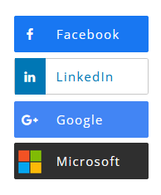
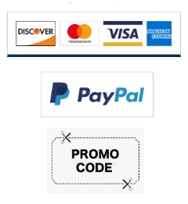
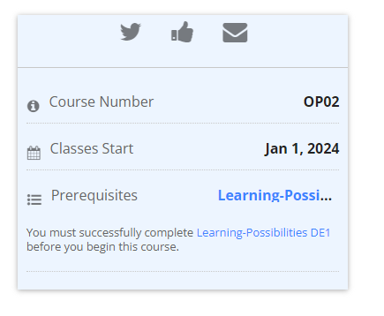
Customer Experience
Registration
Community
Payment Options
Prerequisites
Register using a system account or and of these third-party options.
Courses include Discussion forums, Wiki Pages, Surveys and Polls.
Retail and Institution payment options include Credit Card, PayPal and Promo Codes.
Allowing courses to only become available when prerequisites have been completed.

Slide 6
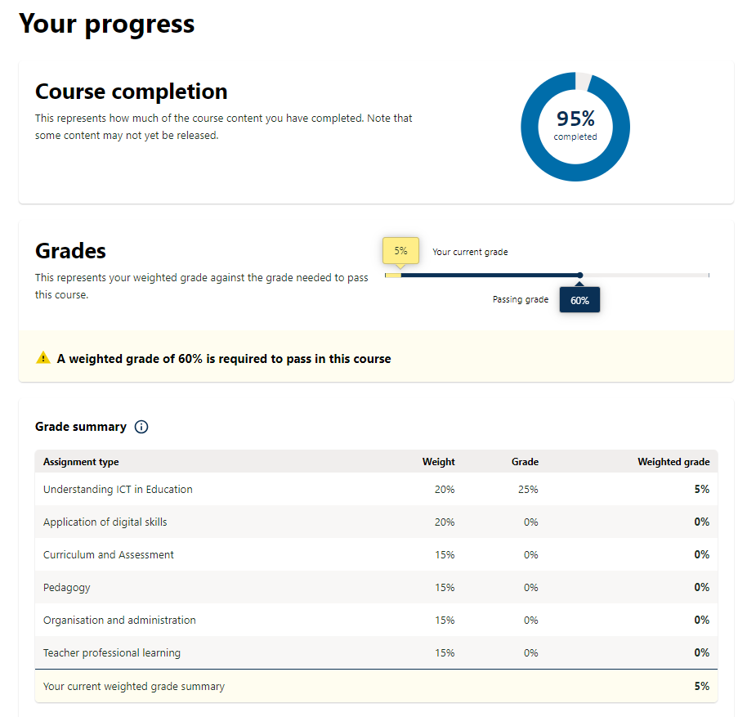
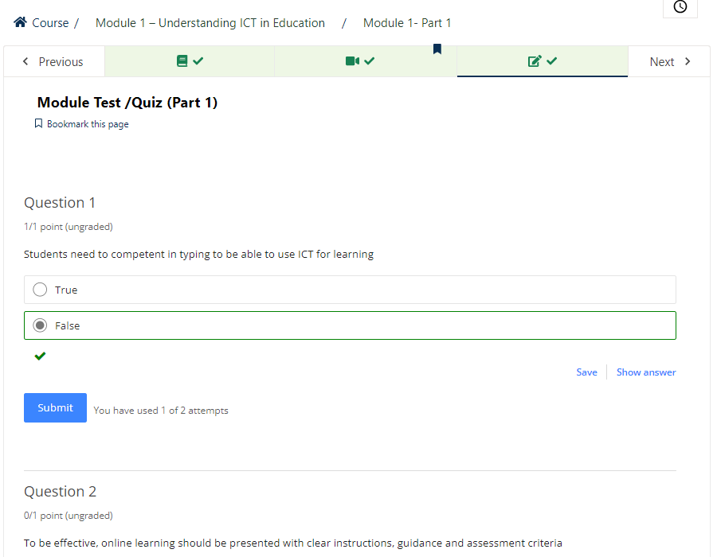
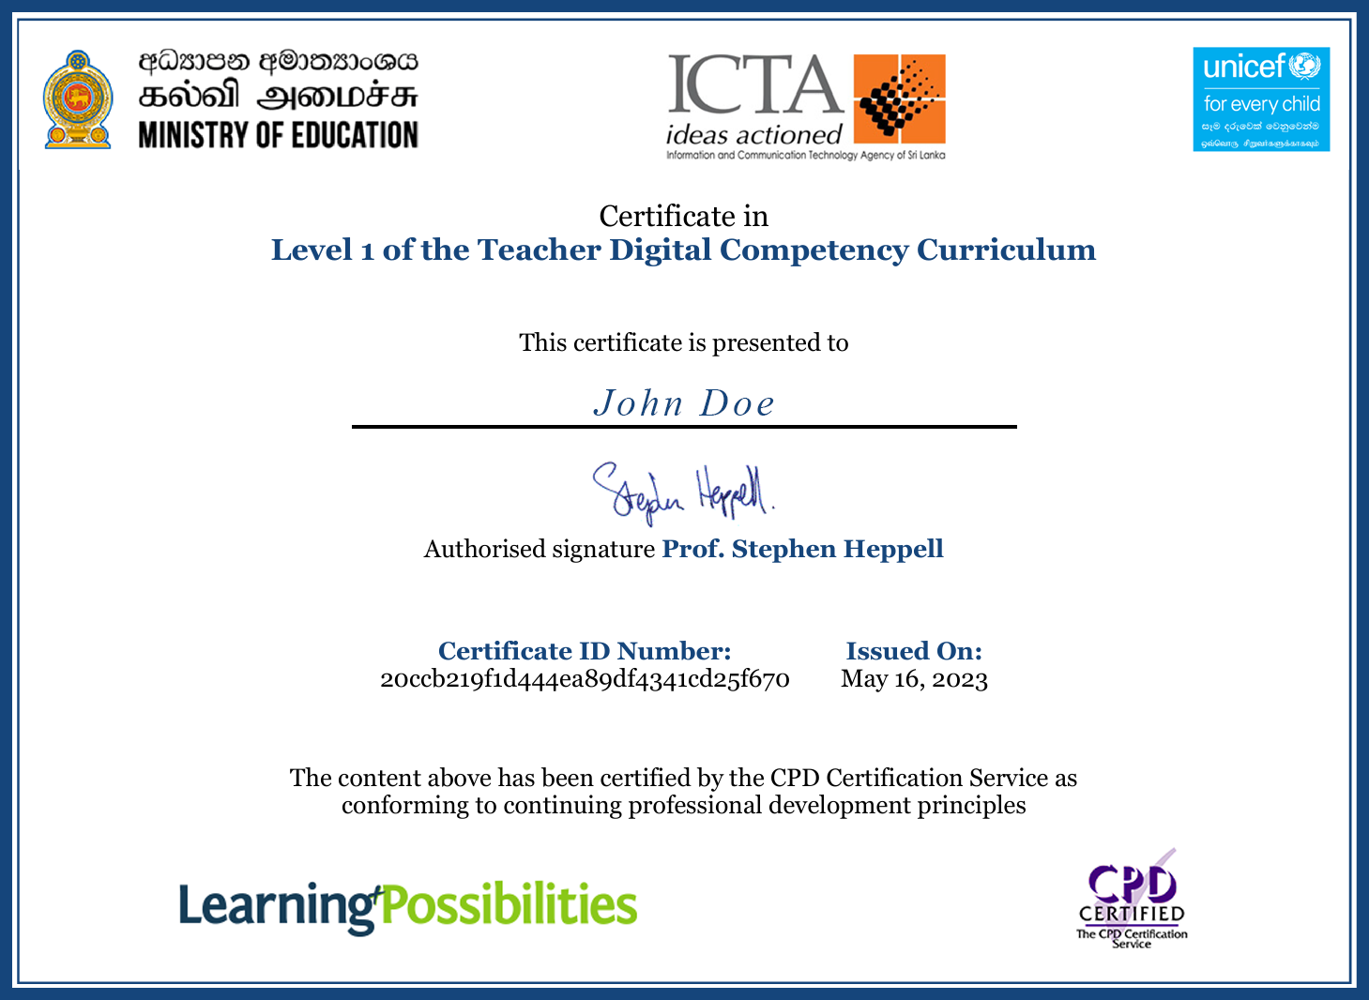
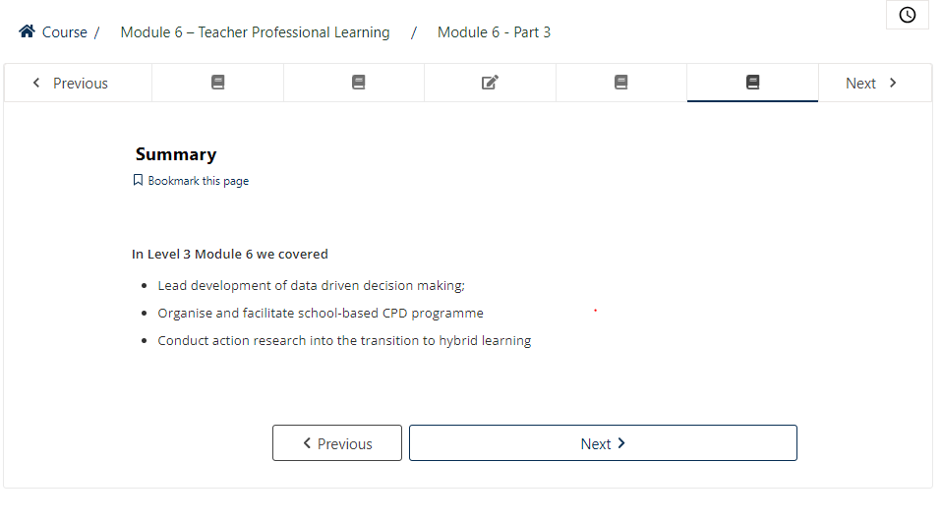
Course Outputs
Summary of acquired knowledge
Progress and Development Reporting
Knowledge check
Certification
Each course summarises what’s been learned
At the end of each course there is a quiz to assess the learner’s knowledge gained.
Reports and insights on learners results and development pathway
All courses and exams come with the option to include personalised user certification

Slide 7
Case Study

Slide 8
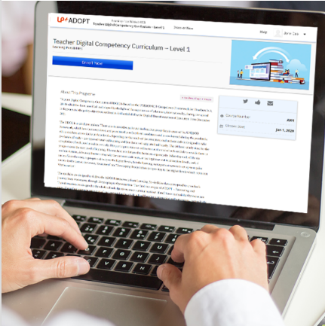
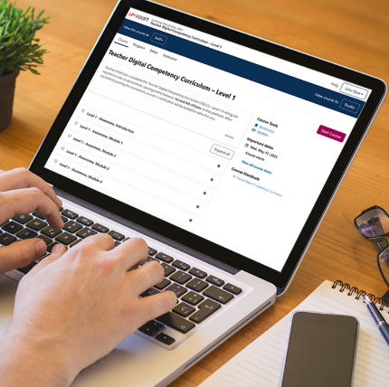
The LP+ADOPT Platform has been used by UNICEF to deliver the Teacher Digital Competency Curriculum nationwide
Case Study – TDCC Sri Lanka
3 levels – Awareness, Development and Optimise
Each level containing over 40 hours of online and in person training
Teachers receive UK CPD Certification upon completion

Slide 9
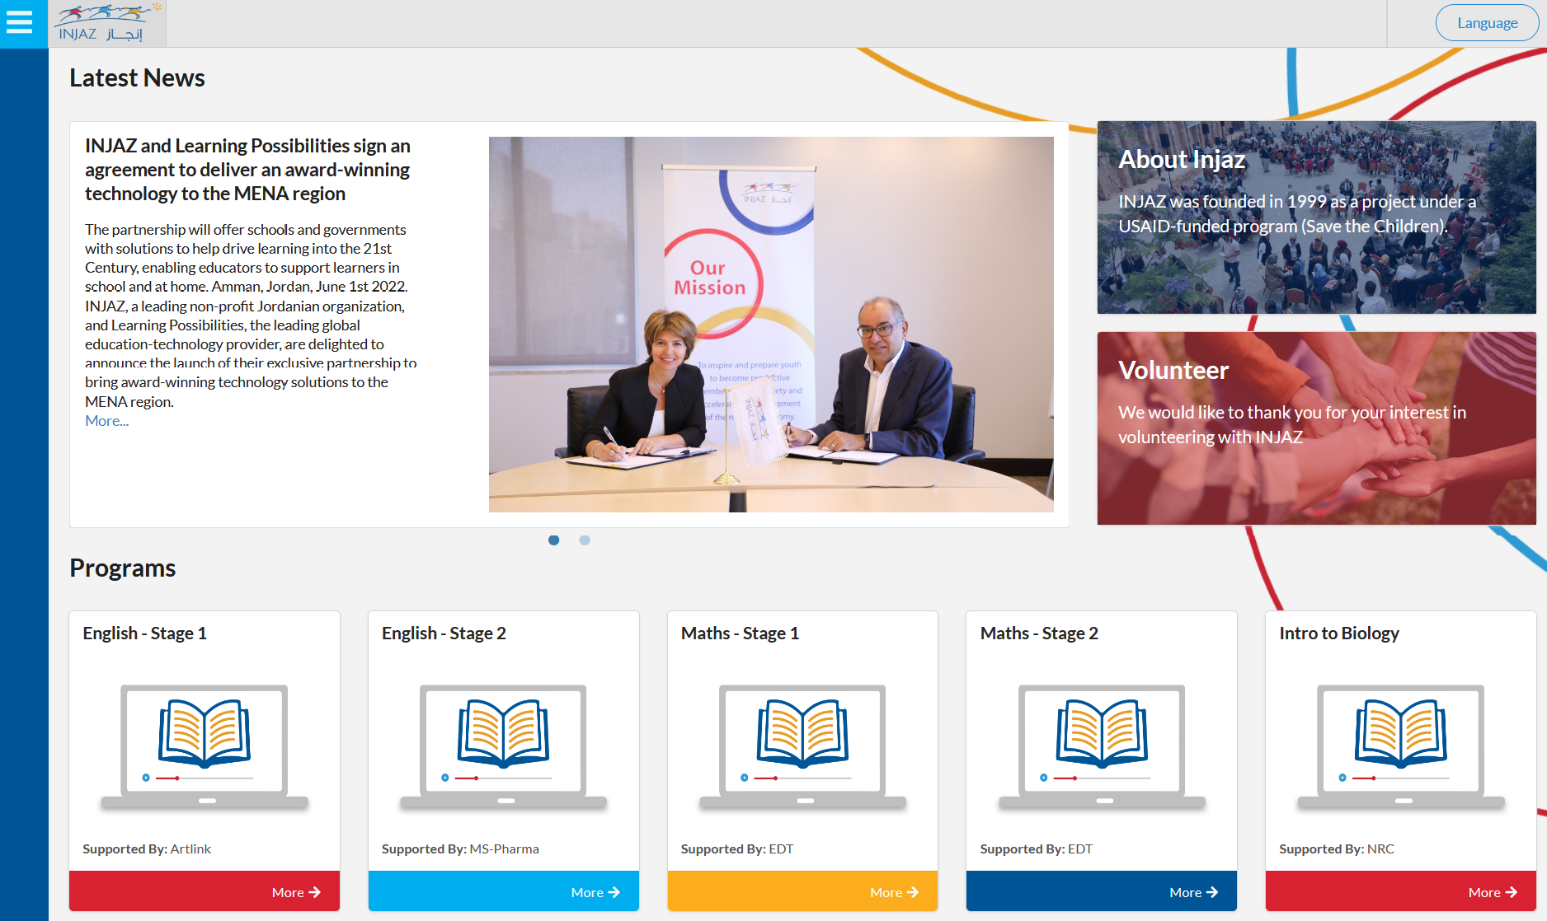
INJAZ Jordan
A custom version of LP+ADOPT was delivered for Injaz in Jordan for the MENA region.
The bespoke platform incorporate these custom features:
Programs: A template that allows new courses with predefined content to be created instantly.
Sessions: Scheduled online Teams sessions for students.
Attendance record.
Pre/Post course Surveys.
Certification.

Slide 10
Commercials

Slide 11
Overall commercial pricing model
Pricing for LP+ADOPT is bespoke, depending on the options chosen from the menu below.
Each project is usually composed of either a fixed price setup and project cost, or a setup cost and a cost per school or learner.
12

Slide 12
Setup options
The following can be customised to your requirements
Solution Branding
Course Content
Reports (Insights and Reflections)
Interactive Dashboard
Registration Portal
Language(s)
Exams and Certification options
Cloud storage options
13

Slide 13
15

