Slide 1
LP+OASIS - Teacher Readiness Diagnostics Report (TRDR) Malinya October 2024
Pitch Deck
© 2024 Learning Possibilities Limited - Company Registered in England and Wales.

Slide 2
The countries referenced in this publication are fictional and used for demonstration purposes. The views expressed are those of the authors and do not necessarily represent the view and policies of Learning Possibilities.
Pitch Deck

Slide 3
Table of Contents
TRDR – An Introduction ​
TRDR Project Context – Malinya ​
TRDR Training – Malinya ​
LP+OASIS Summary – Survey Methodology – Malinya ​
Finding Summary ​
Responses – Cohort Characteristics – Malinya ​
Responses – Cohort Characteristics – Malinya (1/3) ​
Responses – Cohort Characteristics – Malinya (2/3) ​
Responses – Cohort Characteristics – Malinya (3/3) ​
Responses – Average Scores Overall – Malinya​
Average Scores Overall – Malinya​
Responses – Level Achieved Overall – Malinya ​
Level Achieved Overall – Malinya ​
Responses – Level Achieved by Area – Malinya​
Level Achieved by Area – Malinya ​
LP+OASIS participant feedback – Malinya ​
LP+OASIS participant feedback – Malinya
5
6
7
8
9
10
11
12
13
14
15
16
17
18
19
20
21

Slide 4
Table of Contents
Recommendations – Malinya Survey
Recommendations – TRDR Survey
Recommendations – LP+OASIS Survey
Appendix
LP+OASIS Tool
LP+OASIS Tool – An Introduction
The LP+OASIS Tool – Major Features
LP+OASIS – Teacher’s Individual Levelling Up Report Extract
Digital Maturity Proficiency Levels Explained
Participation Certificate for Teachers
Teacher Digital Competency Framework
Teacher Digital Competency Framework – An Introduction
22
23
24
25
26
27
28
29
30
31
32
33

Slide 5
TRDR – An Introduction
TRDR is a multiyear project in four target countries in Africa - Malinya, Buranda, the Zemla, and Elbonia.
The purpose of the project is to understand what educational issues can best be addressed through the intelligent application of Education Technology (EdTech).
After the selection of the individual EdTech interventions for each country, these were allowed to run for one year, in order that sufficient performance data is generated over a manageable time period.
This resulted in capacity-building workshops in the four countries and the progress of the EdTech interventions evaluated.
Further details of this project can be found at www.TRDR.org

Slide 6
TRDR Project Context – Malinya
The objective of the TRDR project in Malinya was to assess the benefits of EdTech utilization in school and at home by both students and teachers and to assess the advantage for students of accessing EdTech devices outside school.
To deliver this objective, there were workshops for the development of teachers’ skills with the aim of promoting student-centred learning techniques.
Phase 1 of the project included the provision of training in collaboration with the Kampuchean Action to Promote Education (KAPE) between January and April 2023.
Additional Project-Based Learning (PBL) workshops were organized in July 2023, where the strategies and plans developed by the teachers were discussed, and the methods outlined to further use PBL in the teaching and learning at the schools.

Slide 7
TRDR Training - Malinya
Malinya
Buranda
Zemla
Elbonia
Workshop1 & 2: Sept & Nov 22 in person workshops STEM
Workshop 3: Apr 23 in person workshop STEM
Workshop 4: Jul 23 in person workshop STEM
Workshop 5 & 6: Sept and Oct 2023 in person STEM
Workshop 1: Dec 22 in person STEM
Workshop 2: Feb 23 in person STEM
Workshop 3: Jul 23 in person STEM
Ongoing support provided by TESDA with a 5-day TTT program on Oct 23
Training by Danang University - STEM and PBL: Jan 23
September and Oct 23 - Application training provided by ELSA

Slide 8
LP+OASIS Survey Methodology - Malinya
LP+ OASIS is a secure, scalable, cloud-based full-service survey, data collection and analysis tool. It offers the ability to use any number of frameworks to collect data for either gap analysis or maturity measurement models.
For Malinya, the basic version of the LP+OASIS tool (V1.0) was used, in line with the country's education maturity.
The survey in Malinya was conducted in June and July 2024, at the end of the two-year TRDR intervention project.
The survey incorporating the 14 TRDR Project Trained teachers and 261 other teachers for comparison purposes.
Note: Given the relatively small number of TRDR project trained teachers caution must be used when interpreting the results.

Slide 9
Finding Summary
Over the two years of the TRDR project, the teachers were given 3 workshops to help them meet the objectives of the intervention.
The workshops for this project focused on the development of teachers’ skills with the aim of promoting student-centred learning techniques. In addition, Project-Based Learning (PBL) workshops were organized in July 2023, where the strategies and plans developed by the teachers were discussed, and the methods outlined to further use PBL in the teaching and learning at the schools. The benefits of this form of development is clear in the results achieved.
In this survey Malinya has the highest average score, showing that on average its teachers have a higher level of digital maturity than the other countries teachers. There is a 14.63% difference between the TRDR teachers and non-TRDR teachers, which is significantly greater than the other three countries, suggesting that the TRDR project had greater impact in moving teachers to higher levels of digital maturity.
The TRDR teachers no longer have any ‘Digital Uninitiated’, which form between 1% - 3% of non-TRDR teachers in each of the 6 areas. The highest levels of ‘Digital Uninitiated’ and ‘Digital Novices’ are greatest in the areas of ‘assessment’, ‘empowering learners’ and ‘facilitating learners’ digital competencies’. These are higher order thinking skills, and this lack of competency in these areas is common amongst all TRDR countries. It is also noticeable that in each of the 6 areas, there are a greater percentage of ‘Digital Innovator’ amongst the TRDR teachers, as well as fewer ‘Digital Novices’. This trend towards innovators has clear benefits for the school as ‘Digital Innovators’ are those that stand at the forefront of digital innovation in education, setting trends and assisting others on their paths.

Slide 10
Responses – Cohort Characteristics - Malinya
The TRDR cohort surveyed was 14 teachers, and the larger comparator group consisted 261 teachers. The following three slides (pages 11, 12 & 13) demonstrate that the gender, demographics and other characteristics each show a broad range, to ensure that the data is representative of teachers in general.
This includes location (rural, town, city), gender, years using digital technology for teaching, subject(s) taught and teaching experience. These characteristics are searchable individually and combined in the online dashboard.
Whilst the TRDR teacher data is limited to the schools and teachers participating in the TRDR project, the comparator data is from schools and teachers across a wider geography.

Slide 11
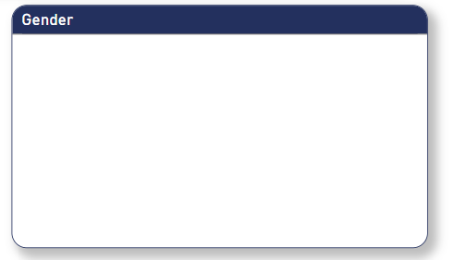
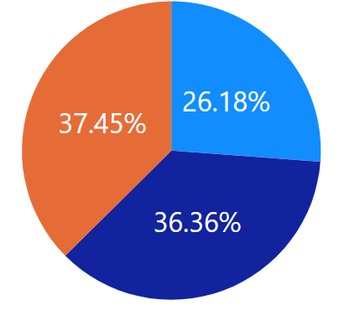
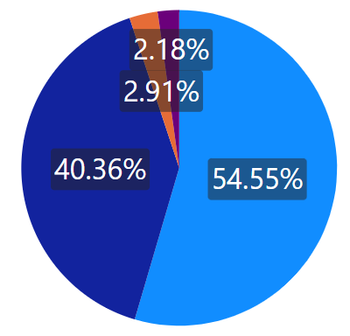
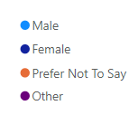
Responses – Cohort Characteristics - Malinya (1/3)
TRDR Trained Staff Responses
All Responses
14
275
Non TRDR Trained Staff Responses
261

Slide 12
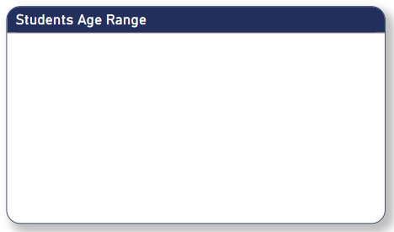
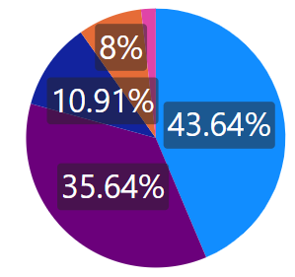
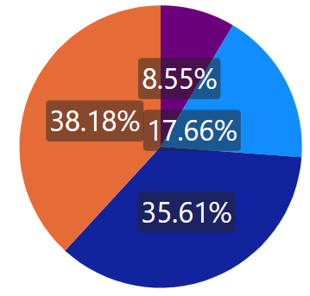
Responses – Cohort Characteristics - Malinya (2/3)
TRDR Trained Staff Responses
All Responses
14
275
Non TRDR Trained Staff Responses
261

Slide 13
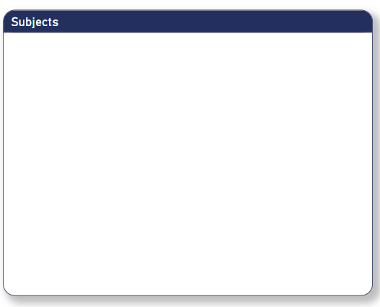
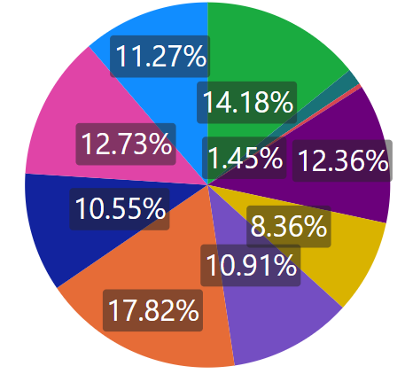
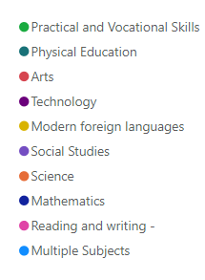
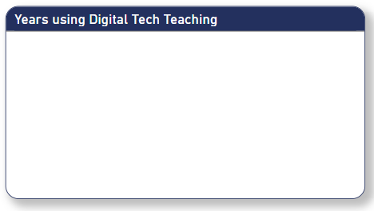
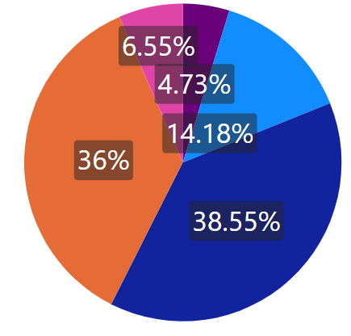
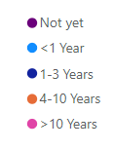
Responses – Cohort Characteristics - Malinya (3/3)
TRDR Trained Staff Responses
All Responses
14
275
Non TRDR Trained Staff Responses
261

Slide 14
Responses - Average Scores Overall - Malinya
Each individual teacher's overall score is calculated across the 6 areas of the TDC framework; professional development, digital resources, teaching and learning, assessment, empowering learners, facilitating learners’ digital competency.
The 32 self-reflection statements across the 6 areas each have 4 options, each mapped to a maturity level; Digital Uninitiated, Digital Novice, Digital Practitioner and Digital Innovator. These are weighted to give a percentage score, thereby showing a score by area and an overall score for each teacher.
As the basic version of the LP+OASIS tool (V1.0) was used in the Malinya as well as Buranda and Elbonia, the scores can be directly compared, subject to the expressed caution in using small numbers.
The average of these scores, gives a score for the country. In this survey Malinya has the highest average score, showing that on average its teachers have a higher level of digital maturity than the other countries teachers.
There is a 14.63% difference between the TRDR teachers and non-TRDR teachers, which is significantly greater than the other three countries, suggesting that the TRDR project had greater impact in moving teachers to higher levels of digital maturity.
The difference in average scores between the TRDR teachers and non-TRDR teachers is negligible between rural and urban areas, however male respondents show a greater difference percentage (20.14%) than female respondents (7.93%).

Slide 15
Average Scores Overall - Malinya
Overall Average %
TRDR Staff Average %
Non TRDR Staff Average %
Malinya
52.91%
66.79%
52.16%
Buranda
47.75%
42.00%
48.76%
Zemla
34.60%
35.43%
34.59%
Elbonia
43.94%
46.50%
43.83%
Overall
44.84%
47.68%
44.83%

Slide 16
Responses - Level Achieved Overall - Malinya
The score achieved by each teacher for each area and the average overall translates to a level of digital maturity. For example, an overall average score between somebody scoring between 34% - 67% would classify the teacher as a Digital Practitioner.
With just 14 TRDR trained teachers it is difficult to have an accurate comparison, and filtering out teachers to give a more accurate like-for-like comparison reduces the number even further.
The non-TRDR teachers show that 21.46% of teachers are Digital Novices. This compares to just 7.14% amongst the TRDR teachers. At the same time, 21.07% of non-TRDR teachers are Digital Innovators whilst that has risen to 42.86% amongst the TRDR teachers. This demonstrates the shift achieved in digital maturity, through the TRDR project.
Within the 181 non-TRDR trained teachers surveyed, 21.84% are within the bottom two levels of competency (Digital Uninitiated and Digital Novice), whilst 21.07% have achieved the highest level of competency available in version 1.0 (Digital Innovator).
The majority of teachers fall within the ‘Digital Practitioner’ category (57.09%), indicating that they are ‘integrating digital technologies into your daily practices’ but have not yet reached the level of ‘ a leader, setting trends and assisting others on their paths.’

Slide 17
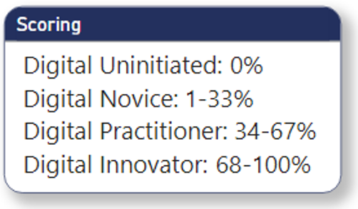
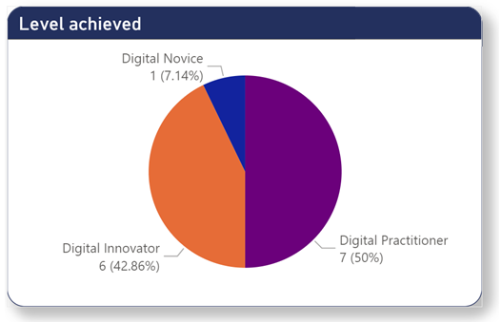
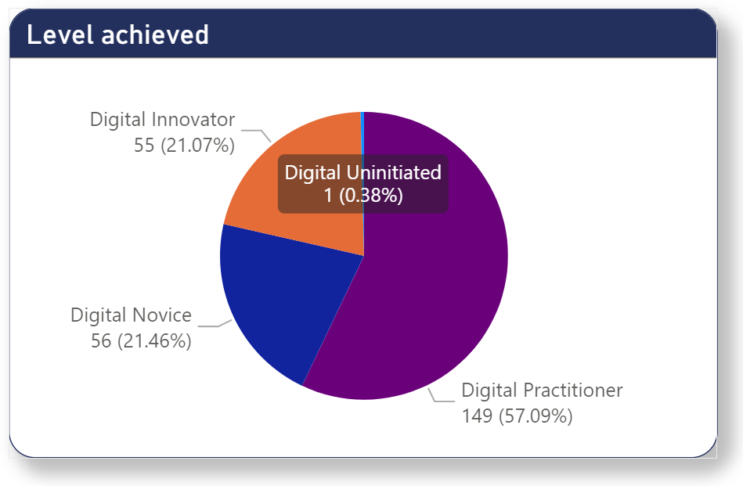
Level Achieved Overall - Malinya
TRDR Trained Staff Responses
Non TRDR Trained Staff Responses
14
261

Slide 18
Level Achieved by Area - Malinya
In the next slide (page 19), for both TRDR and non-TRDR teachers, each of the 6 LP+OASIS areas has been analysed so show how many teachers have attained each level of maturity.
The workshops for this project focused on the development of teachers’ skills with the aim of promoting student-centered learning techniques. In addition, Project-Based Learning (PBL) workshops were organized in July 2023, where the strategies and plans developed by the teachers were discussed, and the methods outlined to further use PBL in the teaching and learning at the schools. The benefits of this form of development is clear in the results achieved.
The TRDR teachers no longer have any ‘Digital Uninitiated’, which form between 1% - 3% of non-TRDR teachers in each of the 6 areas. The highest levels of ‘Digital Uninitiated’ and ‘Digital Novices’ are greatest in the areas of ‘assessment’, ‘empowering learners’ and ‘facilitating learners’ digital competencies’. These are higher order thinking skills, and this lack of competency in these areas is common amongst all TRDR countries.
It is noticeable that the TRDR trained teachers do not have ‘Digital Uninitiated’ levels in any of the 6 Areas of the framework.
It is also noticeable that in each of the 6 areas, there are a greater percentage of ‘Digital Innovator’ amongst the TRDR teachers, as well as fewer ‘Digital Novices’. This trend towards innovators has clear benefits for the school as ‘Digital Innovators’ are those that stand at the forefront of digital innovation in education, setting trends and assisting others on their paths.

Slide 19
Level Achieved by Area - Malinya

Slide 20
LP+OASIS participant feedback - Malinya
The LP+OASIS survey concludes with feedback questions regarding the efficacy of the tool and process, as well as the relevance of the self-reflection.
The following slide (page 23) details the findings of the survey.
In relation to relevance, 86.84% of the participants ‘agreed’ or ‘strongly agreed’ that ‘the questions relate to my everyday practice’. In addition, 88.31% ‘agreed’ or ‘strongly agreed’ that ‘the questions are relevant to my professional learning and development’.
On the question ‘the questions help me to LP+OASIS about my digital competence’, 90.36% ‘agreed’ or ‘strongly agreed’.
Overall, LP+OASIS was positively received with over 80% of teachers providing positive feedback.

Slide 21
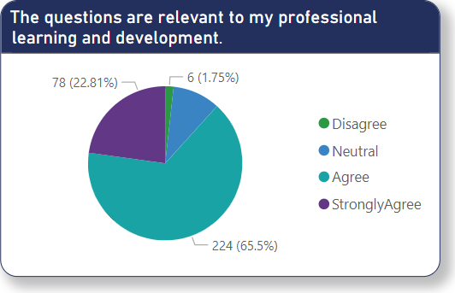
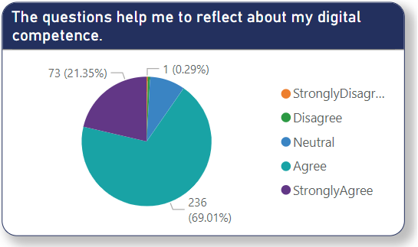
LP+OASIS participant feedback - Malinya
LP+OASIS was positively received by staff with over 80% of staff providing positive feedback.

Slide 22
Recommendations – Malinya Survey
The Average Score in Malinya was 52.91% which relates to ‘Digital Practitioner’ level (34% - 67%). At this level, the ‘journey of integrating digital technologies into your practices’ has just begun. Those who achieve higher levels of digital competency are able to assist other teachers within the school and develop new pedagogical approaches. It is recommended that during capacity building, interventions and strategies are planned to achieve higher overall scores
The Level Achieved by Area shows that the TRDR teachers no longer have any ‘Digital Uninitiated’, which form between 1% - 3% of non-TRDR teachers in each of the 6 areas. The highest levels of ‘Digital Uninitiated’ and ‘Digital Novices’ are greatest in the areas of ‘assessment’, ‘empowering learners’ and ‘facilitating learners’ digital competencies’. These are higher order thinking skills, and this lack of competency in these areas is common amongst all TRDR countries. Therefore, it is recommended that specific development strategies are devised to address these 3 specific areas across all countries.
It is noticeable that none of the TRDR trained teachers is within the lowest level of competency (Digital Uninitiated) in any of the six areas. The highest levels of competency range is between 16.48% - 22.99% of teachers surveyed. For the reasons above, it is recommended that strategies are developed to achieve the highest levels of digital competency in all six areas to benefit from new and innovative technology.
There is a negligible difference in average scores between rural and urban areas, the genders and teaching experience. However, subject to the small number of TRDR trained respondents, there seems to be a significant gender gap when considering non TRDR trained and TRDR trained teachers, with male teachers showing an improvement of 20.14% and female teachers showing only a 7.93% improvement. It is recommended that there is further monitoring the impact of professional development between male and female teachers and those teaching maths and science verses other subjects.

Slide 23
Recommendations – TRDR Survey
The Average Scores Overall across the four countries ranged from 34.60% to 52.91%. These represent the range of advanced levels of digital competency but is lower than the highest levels which start at 68.00% and offer benefits to the whole school as these teachers ‘.. help other teachers seize the potential of digital technologies for enhancing teaching and learning’ and ‘.. experiment with highly innovative and complex digital technologies and/or develop novel pedagogical approaches.’ It is recommended that strategies are developed across all countries to achieve these higher overall average scores.’
The Level Achieved by Area in all four countries shows a remarkedly even distribution across all 6 areas of the framework. It is worth noting that amongst the non TRDR-trained staff, the ‘Digital Uninitiated’ are greatest in the areas of ‘assessment’, ‘empowering learners’ and ‘facilitating learners’ digital competencies’. These are higher order thinking skills, and this lack of competency in these areas is common amongst all TRDR countries. Therefore, it is recommended that specific development strategies are devised to address these 3 specific areas across all countries.
It is worth noting that none of the TRDR trained teachers is within the lowest level of ‘Digital Uninitiated’ in any of the six areas. Malinya, which achieved the highest overall score of 52.91%, also had the highest percentage of ‘Digital Innovators’ in every area of the framework (an average of 20.12% in each area). For the reasons above, it is recommended that strategies are developed to achieve the highest levels of digital competency in all six areas to benefit from new and innovative technology.

Slide 24
Recommendations – LP+OASIS Tool
In the TRDR project, V1.0 of the LP+OASIS Tool was used in Malinya, Elbonia and Buranda, whilst the more advanced V2.0 was used in the Zemla. Whilst V1.0 is basic and offers simplified scoring and descriptors, to align with the needs and realities of developing educational environments, it is recommended that after an initial 12 months of professional development, V2.0 is used to provide further granularity on competency and hence a more accurate picture.
In order to establish a strong baseline, it is recommended a large scale LP+OASIS survey is undertaken at the outset of any project, ensuring a broad range of gender, demographic and other characteristics. This will allow for determination and analysis of the digital competency within the teacher cohort, as well as areas of development necessary for technology rollout.
The TRDR project provides valuable insights into digital maturity development of the TRDR project and its associated professional development, however with an initial LP+OASIS survey, future surveys of the same cohort will provide clear analysis of the impact of a rollout.
The framework used for LP+OASIS was developed during an ADB project, and its application across multiple developing countries will provide valuable comparative data, indicating priorities and insights.

Slide 25
Appendix
Pitch Deck

Slide 26
LP+OASIS Tool
Pitch Deck

Slide 27
LP+OASIS Tool – An Introduction
LP+OASIS – Teacher Readiness Diagnostic is part of the assessment undertaken in the TRDR project to measure the digital competency of teachers, and how the TRDR project has brought about change. This is to inform future teacher training and development as part of the capacity building plans in the individual countries.
LP+OASIS is a web-based diagnostic and data-gathering tool that allows measurement and analysis of digital competence and maturity, using a framework developed during an ADB project.
The tool is anonymous and used in the four target countries, in local language, to survey teachers using their mobile phones. This was for both TRDR and non-TRDR project schools.
The survey details digital competency, maturity and needs-analysis for capacity building. On completion of the survey, each participant was presented with personalised 20-page reflection report, with details for ‘levelling up’ their skills and competency, together with a participation certificate.
The following 4 slides (pages 28, 29, 30 & 31) depict the LP+OASIS Tool, a sample of the reflection Report for Teachers, an explanation of the levels and the participation certificate offers.

Slide 28
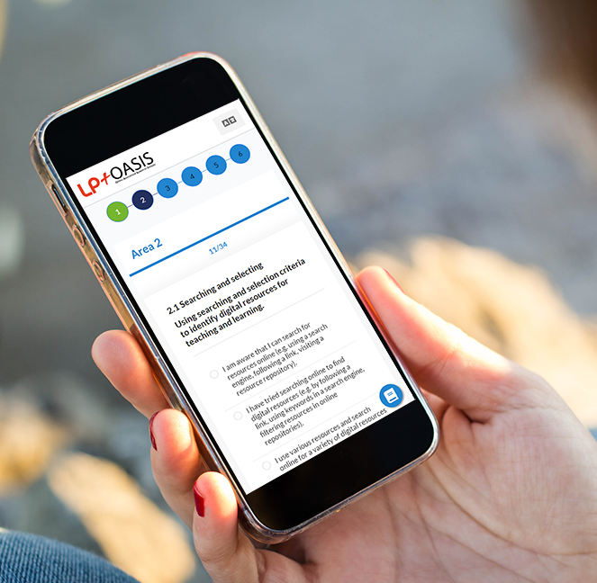
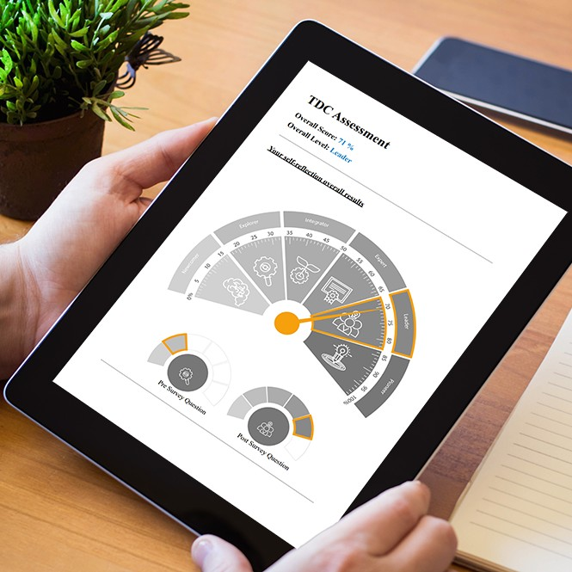
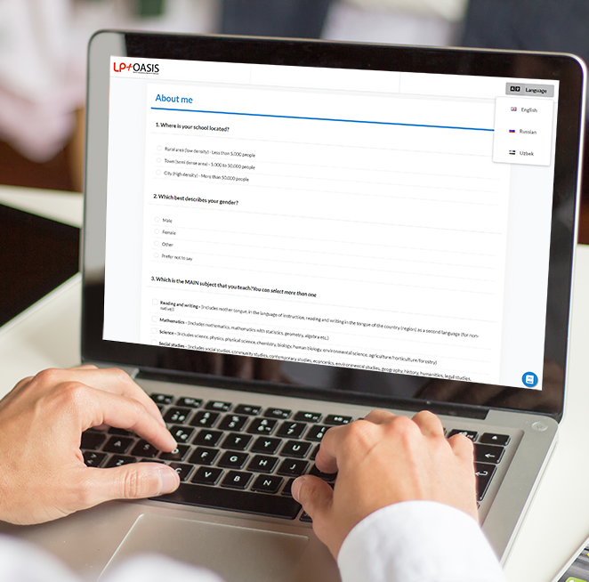
LP+OASIS – Major Features
User surveys for
measurement
User reflections for
personalised development
Interactive data
visualisations

Slide 29
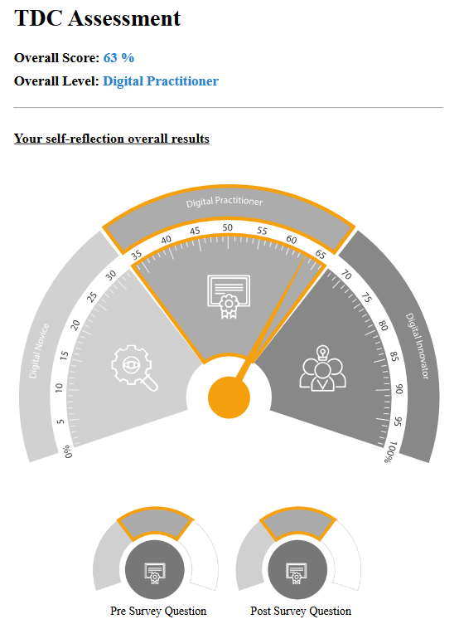
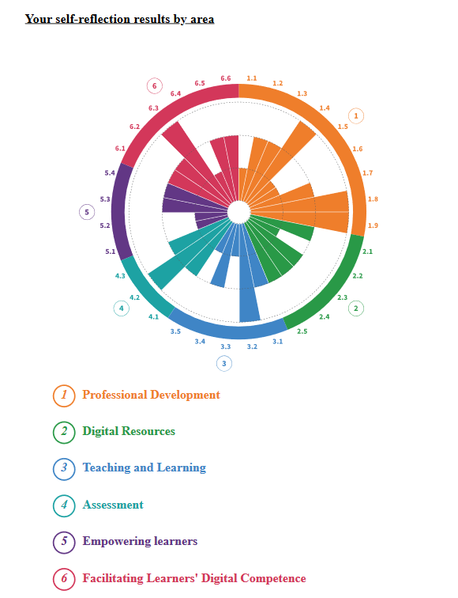
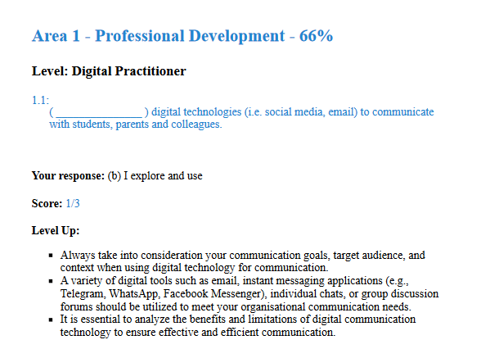
LP+OASIS – Teacher’s Individual Levelling Up Report Extract

Slide 30
Digital Maturity Proficiency Levels Explained
A Level: Digital Uninitiated
You are at the very beginning of your digital journey in education. With the right resources and support, you'll soon find your footing, discovering the endless possibilities that digital integration offers to enhance your teaching.
B Level: Digital Novice
You've might have tried a few digital tools, and you're thinking about how to integrate them more consistently. As you delve deeper, you're eager to understand the myriad ways these tools can augment your teaching strategies, leading you to explore and experiment in different contexts.
C Level: Digital Practitioner
You've moved beyond the basics and are integrating digital technologies into your daily practices. Your toolbox of digital strategies is expanding, and you're mastering the art of choosing the right tool for each situation. You're seeing both the strengths and weaknesses of various digital approaches. And as your expertise grows, you find yourself sharing insights and guiding your peers on their digital journeys.
D Level: Digital Innovator
You stand at the forefront of digital innovation in education. Your approach to using digital technologies is both broad and deep, allowing you to select the best strategies consistently. You're not just a user; you're a leader, setting trends and assisting others on their paths. You continuously update yourself with the latest in digital innovations and are pushing the boundaries in your quest to innovate further. While you're a role model in your community, you remain open and receptive to new ideas, ensuring that you're always ready to take the next innovative step.

Slide 31
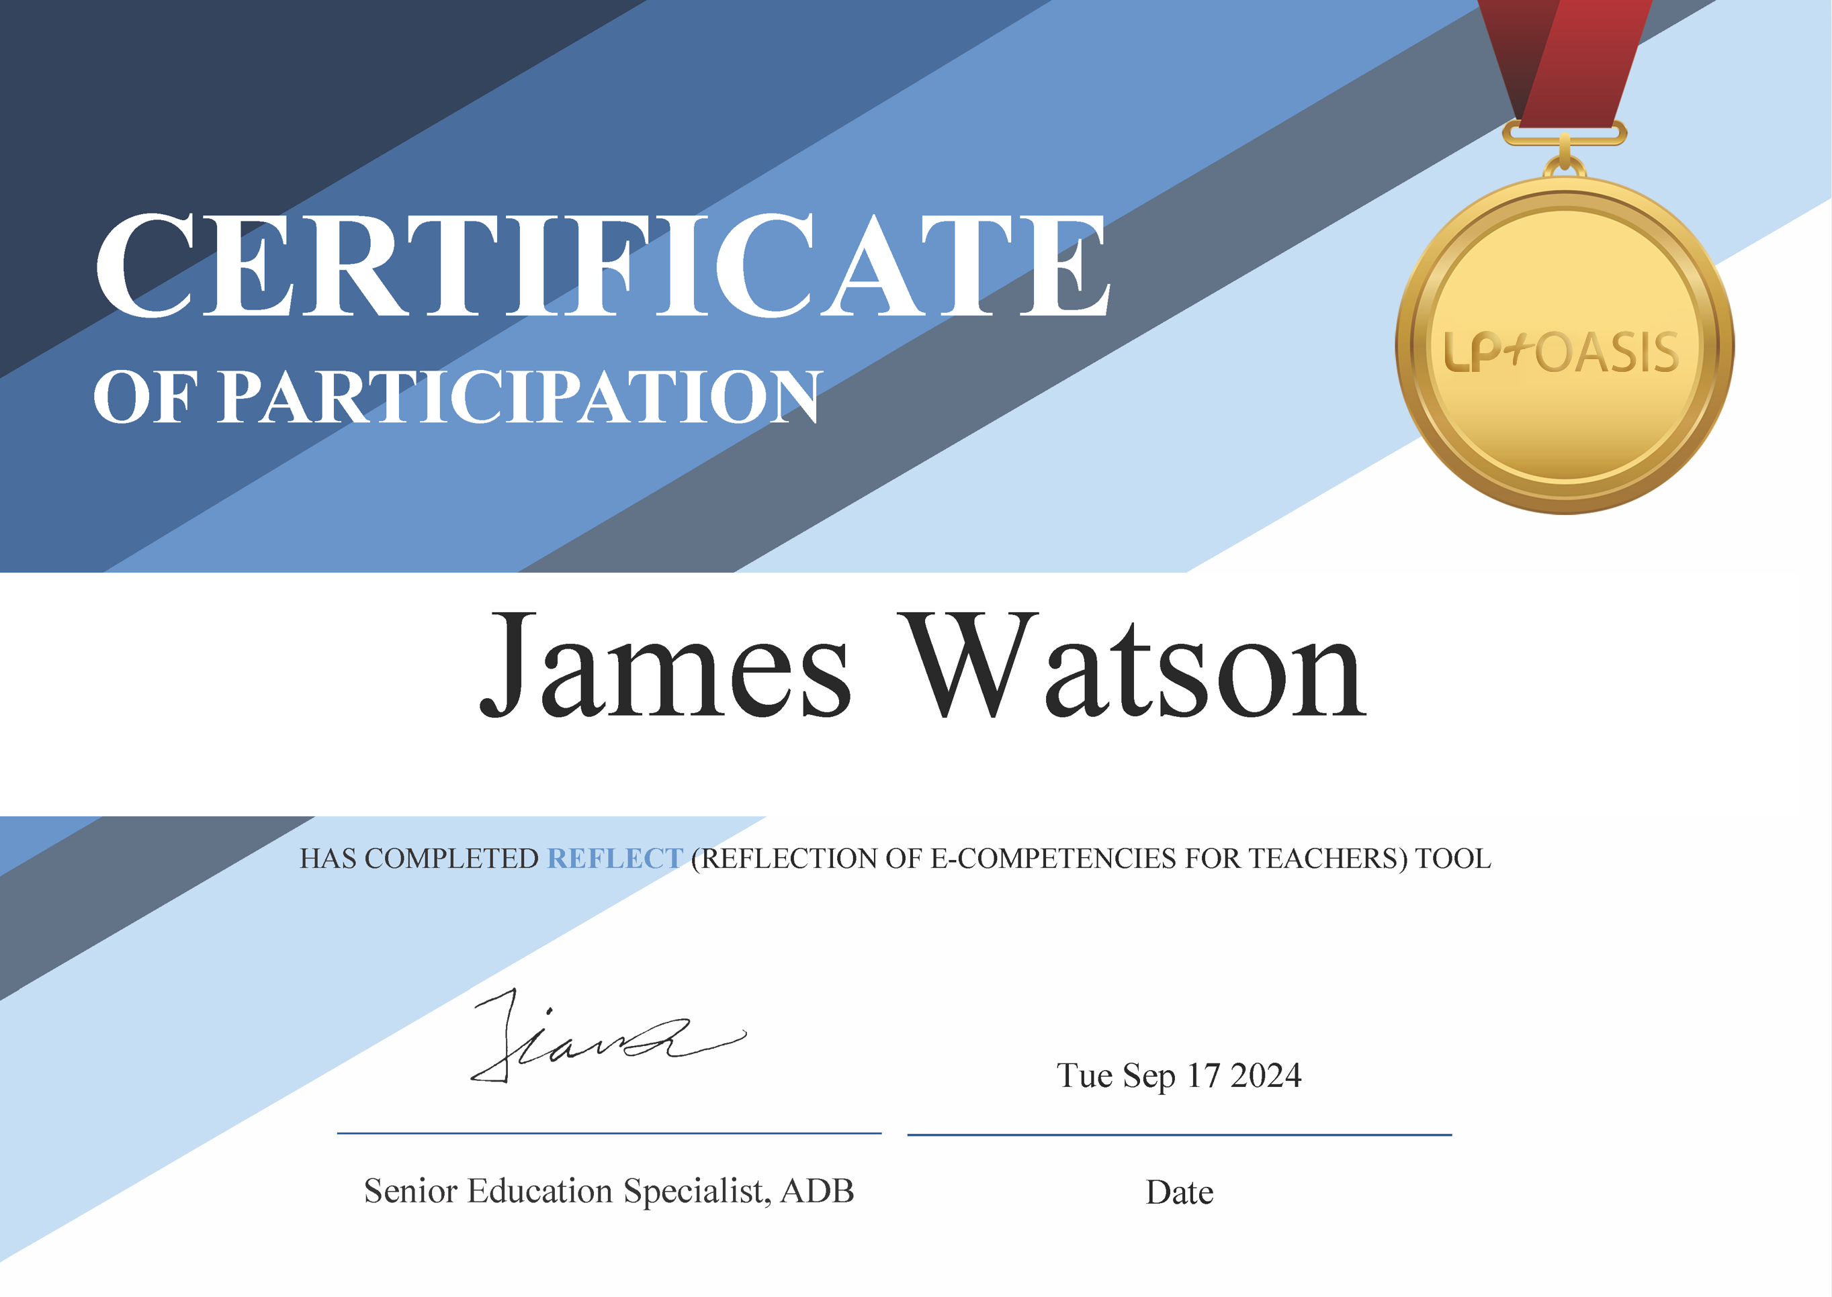
Participation Certificate for Teachers

Slide 32
Teacher Digital Competency framework
Pitch Deck

Slide 33
Teacher Digital Competency Framework – An Introduction
The Teacher Digital Competency (TDC) framework used in the TRDR project is based on the European Framework for the Digital Competence of Educators (DigCompEdu) on which the EU Selfie for Teachers tool is based.
LP+OASIS follows the framework’s six areas of competence, its subareas and provides 32 self-assessment items in total. The items include references to new pedagogical trends and needs, such as computational thinking, online and blended learning, emerging technologies and AI, data management and ethical considerations.
The tool offers survey questions sets at two levels (V1.0 and V2.0), both using the same framework. This allows the tool to be used in nascent and emerging levels of education maturity within the countries. The V1.0, or nascent, set was used in Malinya, Buranda and Elbonia and the emerging version used in the Zemla.
The nascent version simplifies the language and the format of the questions and has 4 levels of maturity; whilst the emerging set has 7 levels of maturity. The use of the same framework across both sets allows for comparison between countries at differing levels of maturity.
The responses by the teacher to each of the 32 self-assessment items, generated a weighted score for each teacher, by area, and for the whole cohort. These scores give a clear indication of the average digital competency, allowing comparison between the countries as well as between the two teacher cohorts.

Slide 34
Thank You
Pitch Deck
© 2024 Learning Possibilities Limited - Company Registered in England and Wales.

